Slide 1

Bitbybit Newsletter Subscription
Presented by – Prashant Mishra

Slide 2
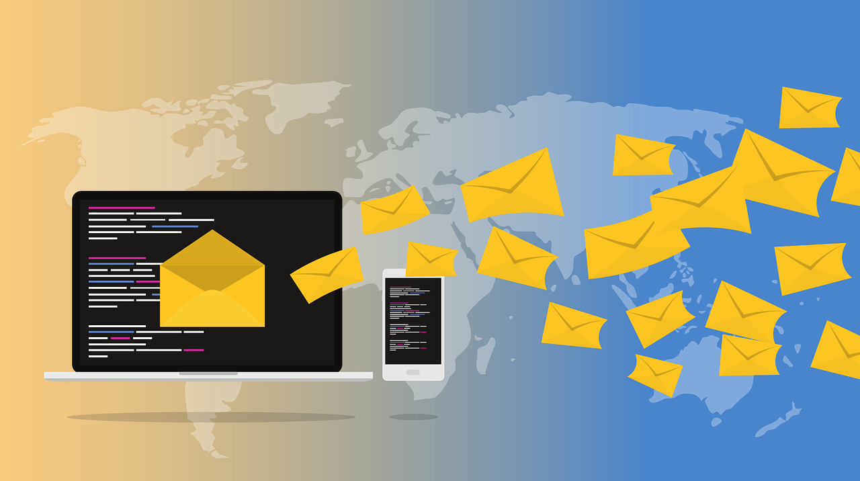
Agenda
Introduction
Tech Stack
What is API?
Mailchimp API
Why Newsletter is important?
System Design
Requirements
Use Case Diagram
E-R Diagram
Screenshots
Conclusion

Slide 3

Introduction
A newsletter is a tool used to communicate regularly with the subscribers, delivering the information customer’s want in their email boxes
BitbyBit is a Node.js based Web App, which allows user to subscribe newsletter subscriptions, powered by Mailchimp API

Slide 4
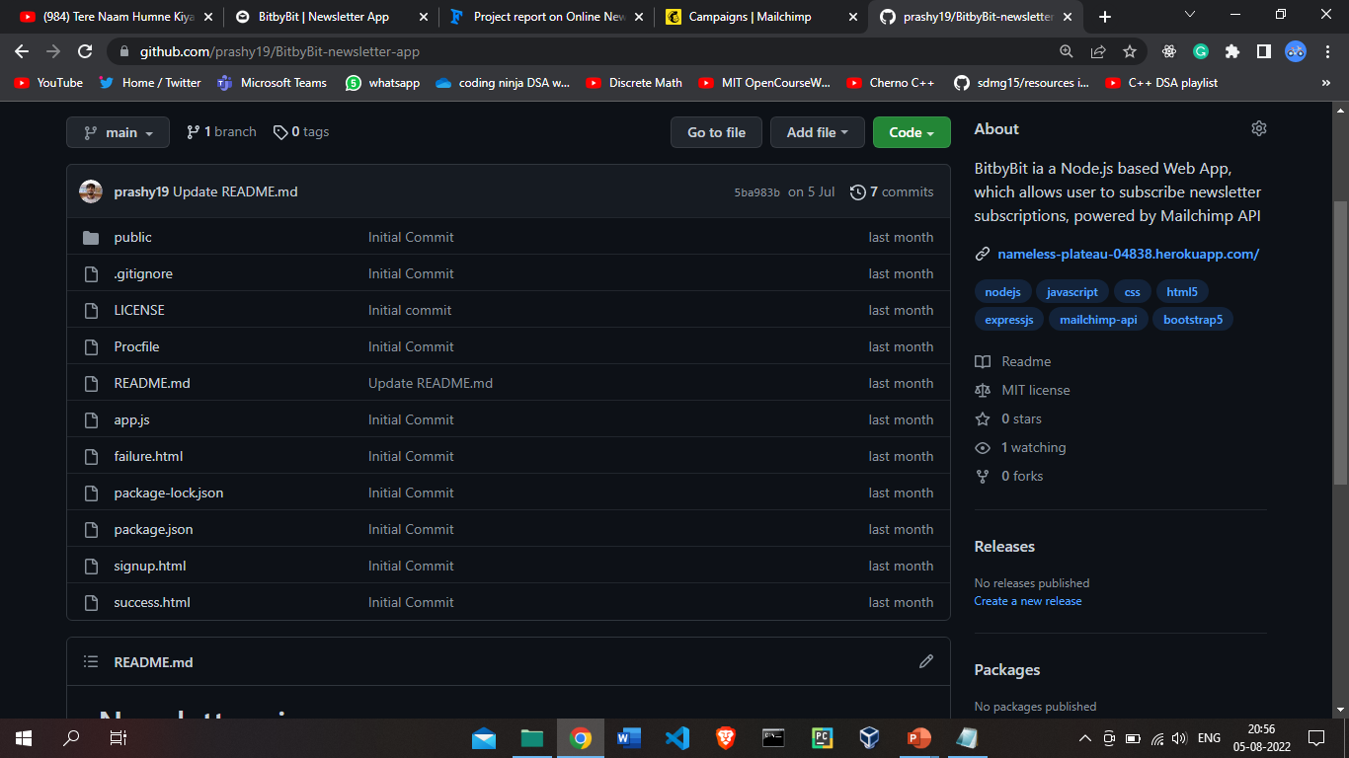
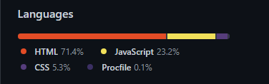
Tech Stack
Implemented with Nodejs and Expressjs on the backend; HTML, CSS and Bootstrap5 on the frontend. The emails are saved to Mailchimp using the Mailchimp API.

Slide 5
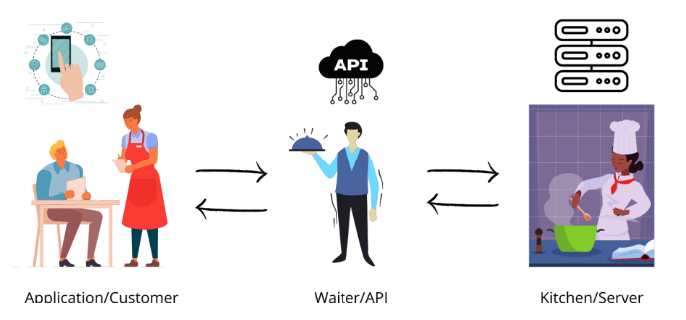
What is API?
Application Programming Interface is a way for two or more computer programs to communicate with each other. It is a type of software interface, offering a service to other pieces of software. A document or standard that describes how to build or use such a connection or interface is called an API specification.

Slide 6

Mailchimp API
The Mailchimp Marketing API provides programmatic access to Mailchimp data and functionality, allowing developers to build custom features to do things like sync email activity and campaign analytics with their database, manage audiences and campaigns, and more. To use the Marketing API, you need a Mailchimp account.

Slide 7
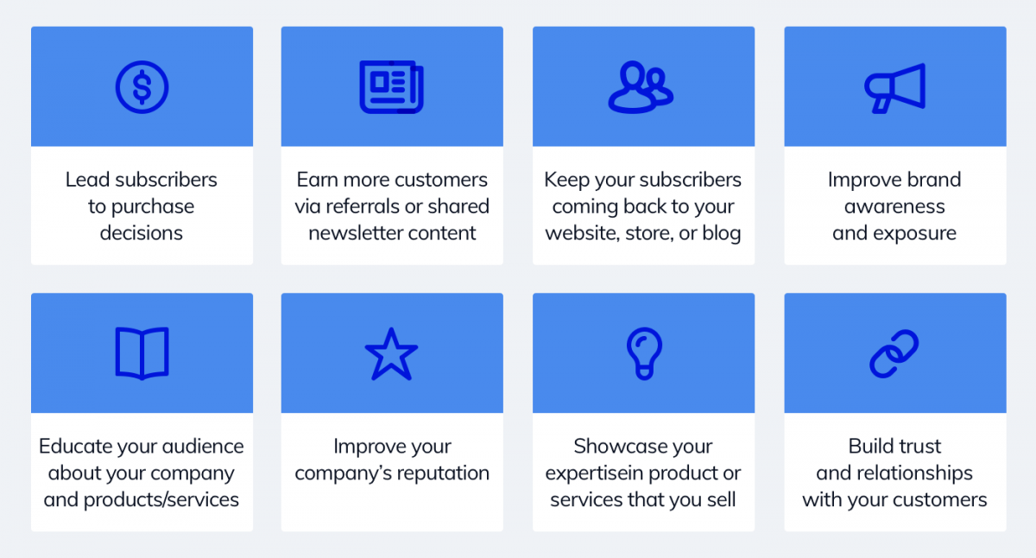
Why Newsletter is important?

Slide 8
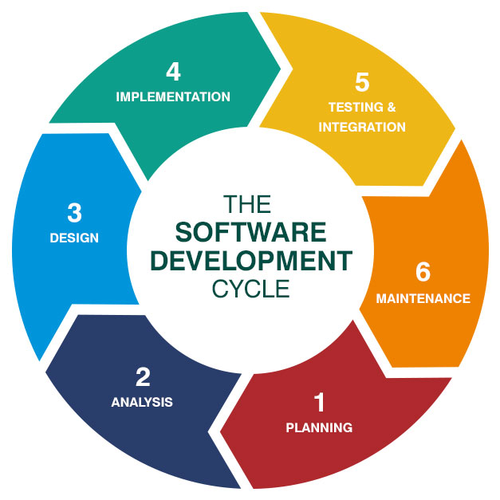
System Design
System design is the process of defining the components, modules, interfaces, and data for a system to satisfy specified requirements. System development is the process of creating or altering systems, along with the processes, practices, models, and methodologies used to develop them.

Slide 9
Requirements
Emails sent to a specific email address are parsed, written to a database, and sent to user’s primary inbox as part of a single weekly email.
Admin can preserve the design of each email newsletter.
Admin can choose ideal frequency (e.g. weekly, bi-weekly, or monthly) and the best time of week to send the newsletter.

Slide 10
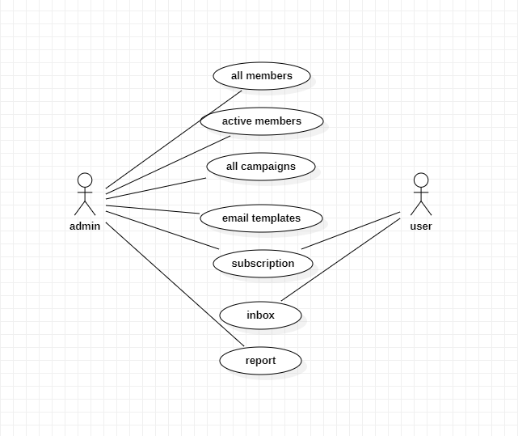
Use Case Diagram
A use case diagram is a graphical depiction of a user's possible interactions with a system. A use case diagram shows various use cases and different types of users the system has and will often be accompanied by other types of diagrams as well. The use cases are represented by either circles or ellipses

Slide 11
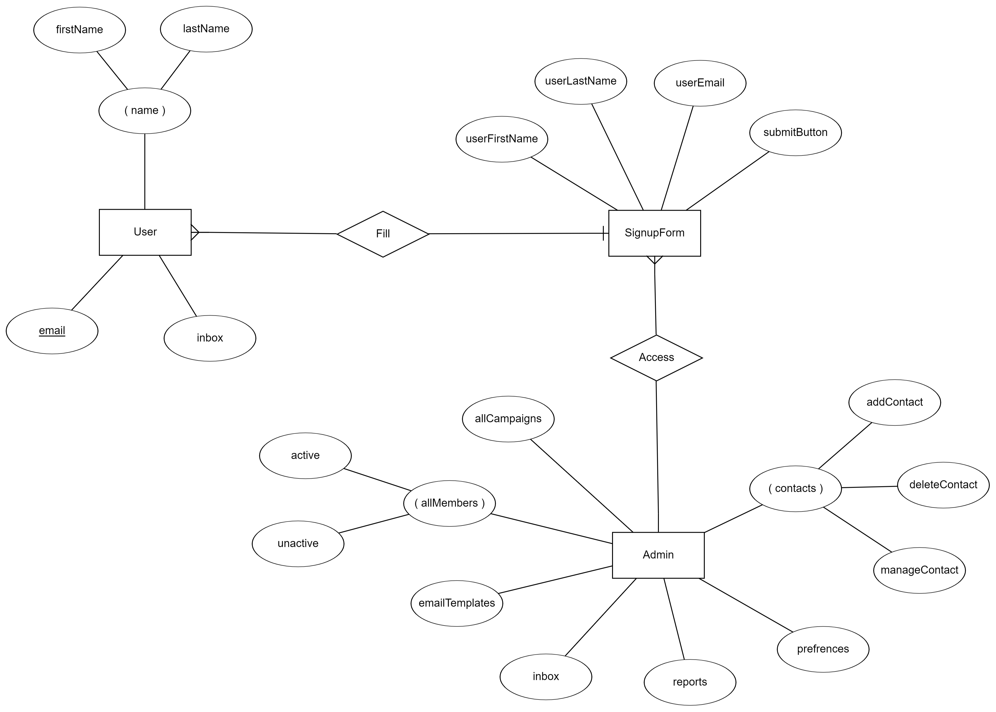
E-R Diagram

Slide 12
Hosted on:
http://nameless-plateau-04838.herokuapp.com/
https://github.com/prashy19/BitbyBit-newsletter-app

Slide 13
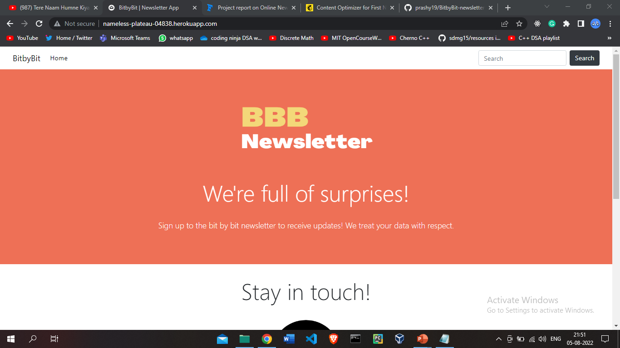
Screenshots

Slide 14
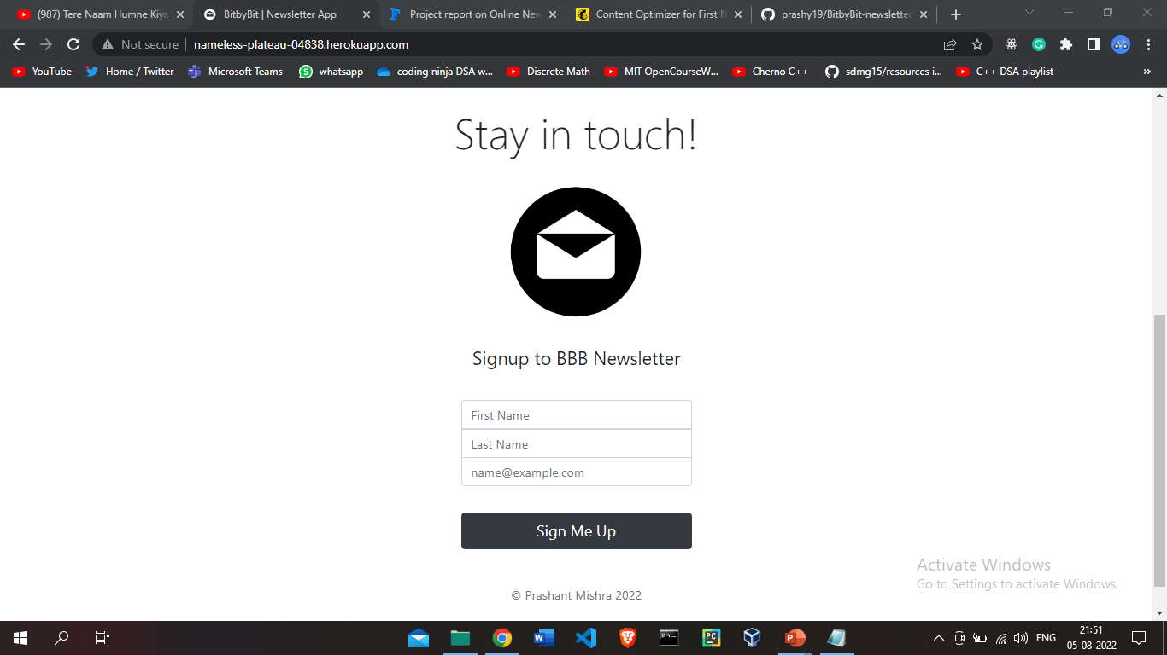

Slide 15
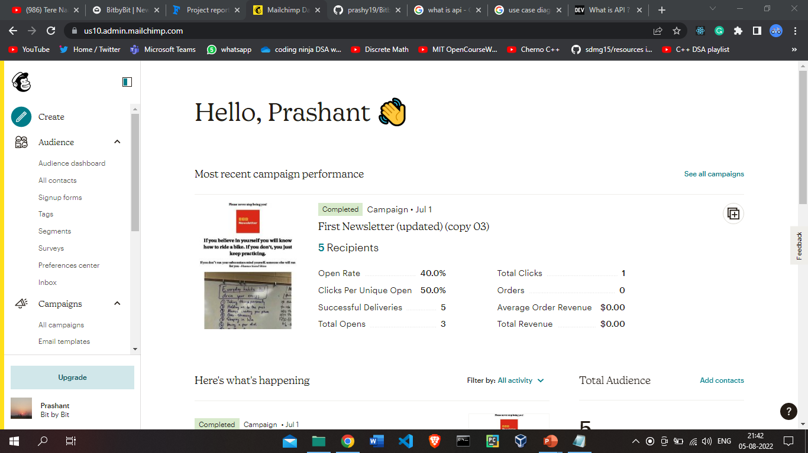

Slide 16
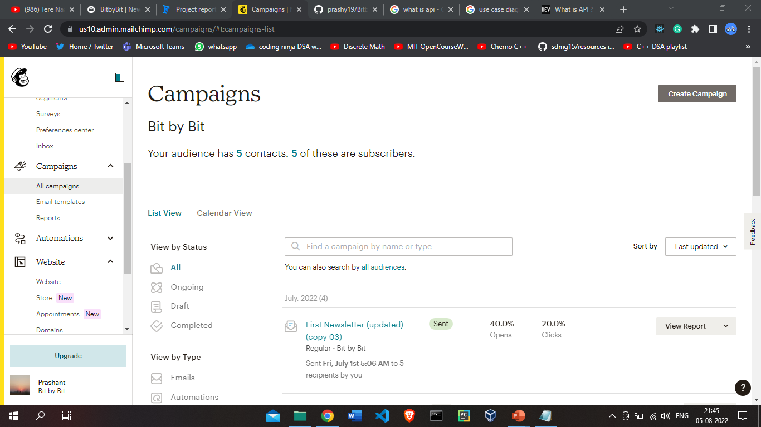

Slide 17
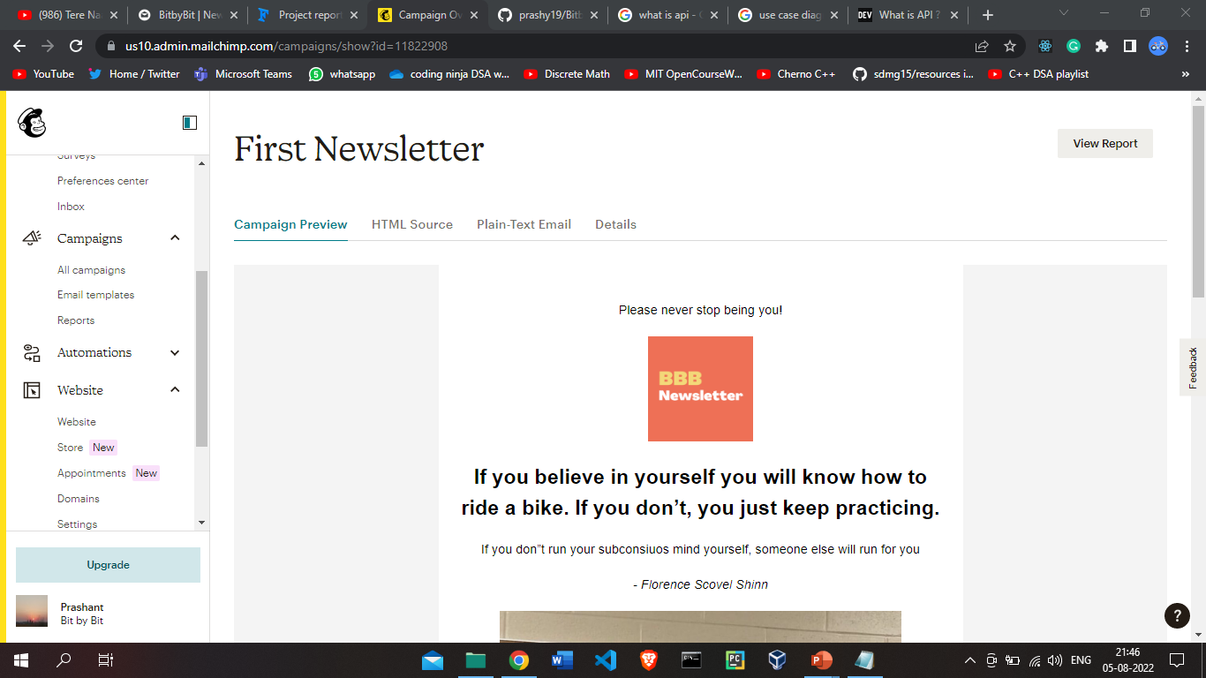

Slide 18
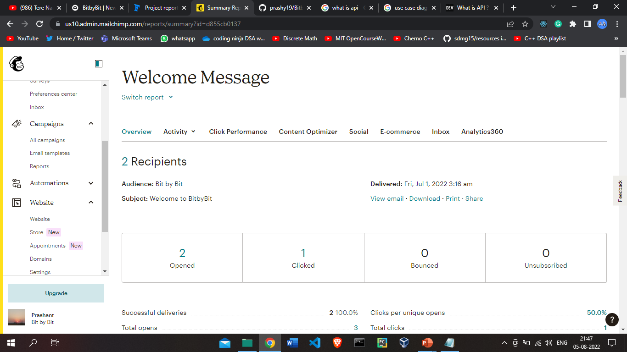

Slide 19
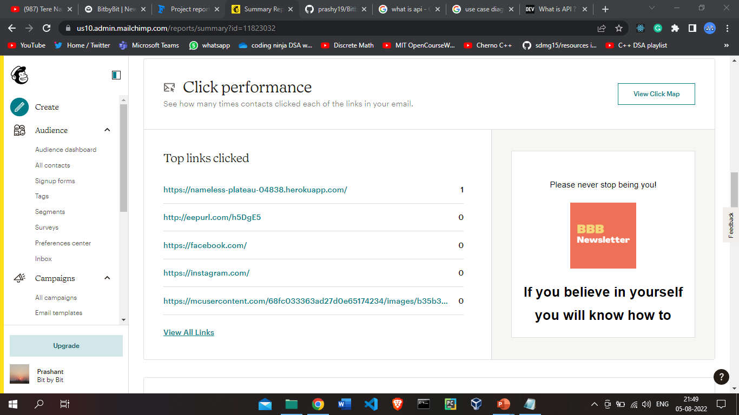

Slide 20
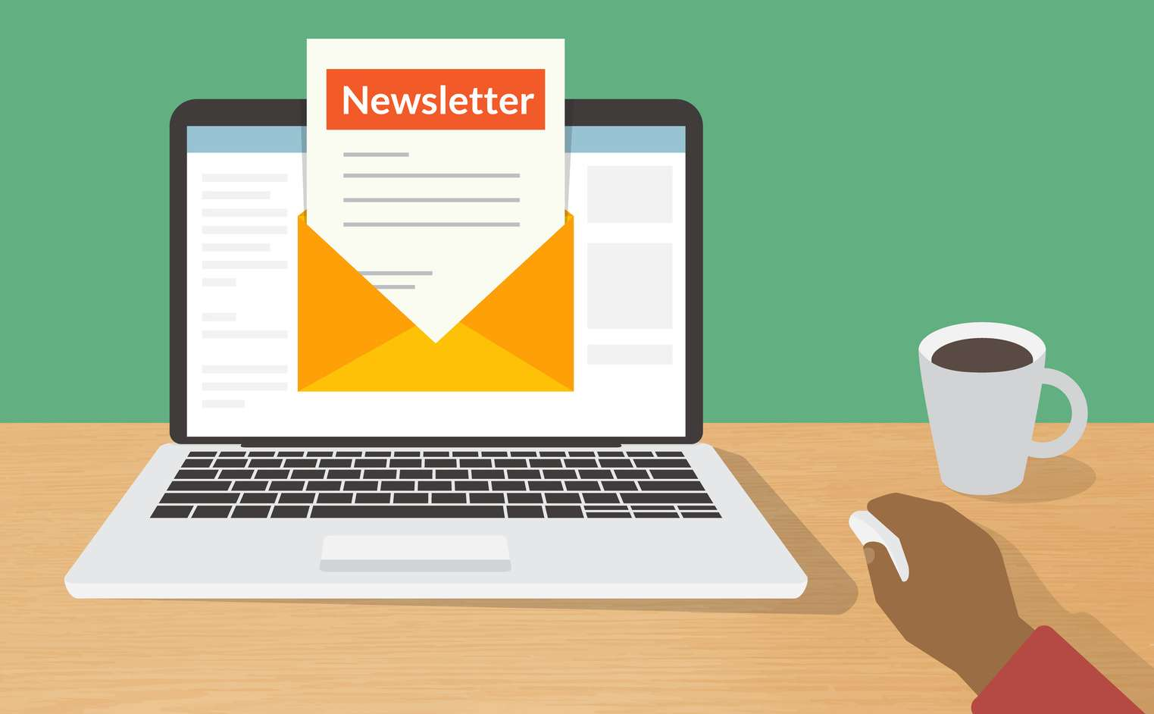
Conclusion
This project is built as serverless app to consolidate user’s email subscriptions into a single weekly summary email in form of newsletter.

Slide 21
Thank you
Prashant Mishra
praashantmishraa@gmail.com
http://nameless-plateau-04838.herokuapp.com/

